Slide 1
Data Mining:
Concepts and Techniques
— Slides for Textbook —
— Chapter 10 —
©Jiawei Han and Micheline Kamber
Intelligent Database Systems Research Lab
School of Computing Science
Simon Fraser University, Canada
http://www.cs.sfu.ca

Slide 2
Chapter 10: Applications and Trends in Data Mining
Data mining applications
Data mining system products and research prototypes
Additional themes on data mining
Social impact of data mining
Trends in data mining
Summary

Slide 3
Data Mining Applications*
Data mining is now a mature discipline with wide and diverse applications
  There is still a nontrivial gap between general principles of data mining and domain-specific, effective data mining tools for particular applications
Some application domains (covered in this chapter)
  Biomedical and DNA data analysis
  Financial data analysis
  Retail industry
  Telecommunication industry

Slide 4
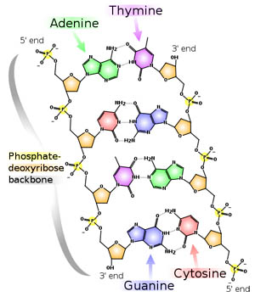
Biomedical Data Mining and DNA Analysis*

Slide 5
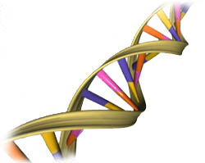
Biomedical Data Mining and DNA Analysis

Slide 6
Biomedical Data Mining and DNA Analysis*
DNA sequences: 4 basic building blocks (nucleotides): adenine (A), cytosine (C), guanine (G), and thymine (T).
Gene: a sequence of hundreds of individual nucleotides arranged in a particular order
Humans have around 100,000 genes
Tremendous number of ways that the nucleotides can be ordered and sequenced to form distinct genes
Semantic integration of heterogeneous, distributed genome databases
  Current: highly distributed, uncontrolled generation and use of a wide variety of DNA data
  Data cleaning and data integration methods developed in data mining will help

Slide 7
DNA Analysis: Examples*
Similarity search and comparison among DNA sequences
  Compare the frequently occurring patterns of each class (e.g., diseased and healthy)
  Identify gene sequence patterns that play roles in various diseases
Association analysis: identification of co-occurring gene sequences
  Most diseases are not triggered by a single gene but by a combination of genes acting together
  Association analysis may help determine the kinds of genes that are likely to co-occur together in target samples
Path analysis: linking genes to different disease development stages
  Different genes may become active at different stages of the disease
  Develop pharmaceutical interventions that target the different stages separately
Visualization tools and genetic data analysis

Slide 8
Data Mining for Financial Data Analysis*
Financial data collected in banks and financial institutions are often relatively complete, reliable, and of high quality
Design and construction of data warehouses for multidimensional data analysis and data mining
  View the debt and revenue changes by month, by region, by sector, and by other factors
  Access statistical information such as max, min, total, average, trend, etc.
Loan payment prediction/consumer credit policy analysis
  feature selection and attribute relevance ranking
  Loan payment performance
  Consumer credit rating

Slide 9
Financial Data Mining*
Classification and clustering of customers for targeted marketing
  multidimensional segmentation by nearest-neighbor, classification, decision trees, etc. to identify customer groups or associate a new customer to an appropriate customer group
Detection of money laundering and other financial crimes
  integration of from multiple DBs (e.g., bank transactions, federal/state crime history DBs)
  Tools: data visualization, linkage analysis, classification, clustering tools, outlier analysis, and sequential pattern analysis tools (find unusual access sequences)

Slide 10
Data Mining for Retail Industry*
Retail industry: huge amounts of data on sales, customer shopping history, etc.
Applications of retail data mining
  Identify customer buying behaviors
  Discover customer shopping patterns and trends
  Improve the quality of customer service
  Achieve better customer retention and satisfaction
  Enhance goods consumption ratios
  Design more effective goods transportation and distribution policies

Slide 11
Data Mining in Retail Industry: Examples
Design and construction of data warehouses based on the benefits of data mining
  Multidimensional analysis of sales, customers, products, time, and region
Analysis of the effectiveness of sales campaigns
Customer retention: Analysis of customer loyalty
  Use customer loyalty card information to register sequences of purchases of particular customers
  Use sequential pattern mining to investigate changes in customer consumption or loyalty
  Suggest adjustments on the pricing and variety of goods
Purchase recommendation and cross-reference of items

Slide 12
Data Mining for Telecomm. Industry (1)*
A rapidly expanding and highly competitive industry and a great demand for data mining
  Understand the business involved
  Identify telecommunication patterns
  Catch fraudulent activities
  Make better use of resources
  Improve the quality of service
Multidimensional analysis of telecommunication data
  Intrinsically multidimensional: calling-time, duration, location of caller, location of callee, type of call, etc.

Slide 13
Data Mining for Telecomm. Industry (2)*
Fraudulent pattern analysis and the identification of unusual patterns
  Identify potentially fraudulent users and their atypical usage patterns
  Detect attempts to gain fraudulent entry to customer accounts
  Discover unusual patterns which may need special attention
Multidimensional association and sequential pattern analysis
  Find usage patterns for a set of communication services by customer group, by month, etc.
  Promote the sales of specific services
  Improve the availability of particular services in a region
Use of visualization tools in telecommunication data analysis

Slide 14
Chapter 10: Applications and Trends in Data Mining
Data mining applications
Data mining system products and research prototypes
Additional themes on data mining
Social impact of data mining
Trends in data mining
Summary

Slide 15
How to choose a data mining system?*
Commercial data mining systems have little in common
  Different data mining functionality or methodology
  May even work with completely different kinds of data sets
Need multiple dimensional view in selection
Data types: relational, transactional, text, time sequence, spatial?
System issues
  running on only one or on several operating systems?
  a client/server architecture?
  Provide Web-based interfaces and allow XML data as input and/or output?

Slide 16
How to Choose a Data Mining System? (2)*
Data sources
  ASCII text files, multiple relational data sources
  support ODBC connections (OLE DB, JDBC)?
Data mining functions and methodologies
  One vs. multiple data mining functions
  One vs. variety of methods per function
    More data mining functions and methods per function provide the user with greater flexibility and analysis power
Coupling with DB and/or data warehouse systems
  Four forms of coupling: no coupling, loose coupling, semitight coupling, and tight coupling
    Ideally, a data mining system should be tightly coupled with a database system

Slide 17
How to Choose a Data Mining System? (3)*
Scalability
  Row (or database size) scalability
  Column (or dimension) scalability
  Curse of dimensionality: it is much more challenging to make a system column scalable that row scalable
Visualization tools
  “A picture is worth a thousand words”
  Visualization categories: data visualization, mining result visualization, mining process visualization, and visual data mining
Data mining query language and graphical user interface
  Easy-to-use and high-quality graphical user interface
  Essential for user-guided, highly interactive data mining

Slide 18
Examples of Data Mining Systems (1)*
IBM Intelligent Miner
  A wide range of data mining algorithms
  Scalable mining algorithms
  Toolkits: neural network algorithms, statistical methods, data preparation, and data visualization tools
  Tight integration with IBM's DB2 relational database system
SAS Enterprise Miner
  A variety of statistical analysis tools
  Data warehouse tools and multiple data mining algorithms
Mirosoft SQLServer 2000
  Integrate DB and OLAP with mining
  Support OLEDB for DM standard

Slide 19
Examples of Data Mining Systems (2)*
SGI MineSet
  Multiple data mining algorithms and advanced statistics
  Advanced visualization tools
Clementine (SPSS)
  An integrated data mining development environment for end-users and developers
  Multiple data mining algorithms and visualization tools
DBMiner (DBMiner Technology Inc.)
  Multiple data mining modules: discovery-driven OLAP analysis, association, classification, and clustering
  Efficient, association and sequential-pattern mining functions, and visual classification tool
  Mining both relational databases and data warehouses

Slide 20
Chapter 10: Applications and Trends in Data Mining
Data mining applications
Data mining system products and research prototypes
Additional themes on data mining
Social impact of data mining
Trends in data mining
Summary

Slide 21
Visual Data Mining*
Visualization: use of computer graphics to create visual images which aid in the understanding of complex, often massive representations of data
Visual Data Mining: the process of discovering implicit but useful knowledge from large data sets using visualization techniques
Purpose of Visualization
  Gain insight into an information space by mapping data onto graphical primitives
  Provide qualitative overview of large data sets
  Search for patterns, trends, structure, irregularities, relationships among data.
  Help find interesting regions and suitable parameters for further quantitative analysis.
  Provide a visual proof of computer representations derived

Slide 22
Visual Data Mining & Data Visualization
Integration of visualization and data mining
  data visualization
  data mining result visualization
  data mining process visualization
  interactive visual data mining
Data visualization
  Data in a database or data warehouse can be viewed
    at different levels of granularity or abstraction
    as different combinations of attributes or dimensions
  Data can be presented in various visual forms

Slide 23
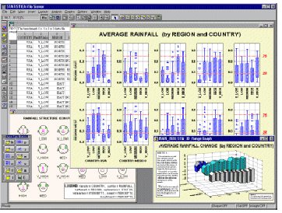
Boxplots from Statsoft: multiple variable combinations

Slide 24
Data Mining Result Visualization*
Presentation of the results or knowledge obtained from data mining in visual forms
Examples
  Scatter plots and boxplots (obtained from descriptive data mining)
  Decision trees
  Association rules
  Clusters
  Outliers
  Generalized rules

Slide 25
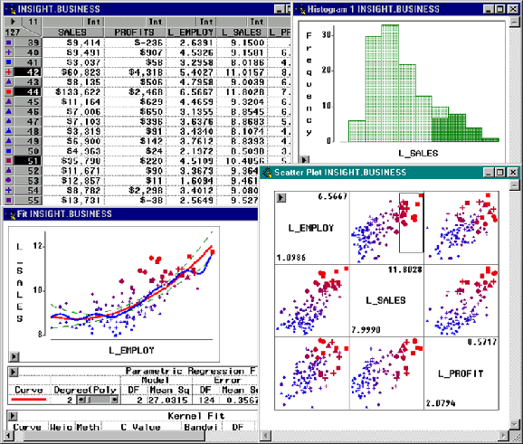
Visualization of data mining results in SAS Enterprise Miner: scatter plots

Slide 26

Visualization of association rules in MineSet 3.0

Slide 27

Visualization of a decision tree in MineSet 3.0

Slide 28
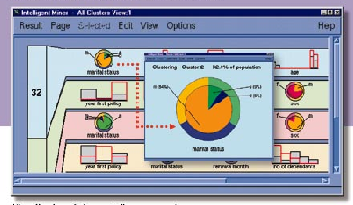
Visualization of cluster groupings in IBM Intelligent Miner

Slide 29
Data Mining Process Visualization*
Presentation of the various processes of data mining in visual forms so that users can see
  How the data are extracted
  From which database or data warehouse they are extracted
  How the selected data are cleaned, integrated, preprocessed, and mined
  Which method is selected at data mining
  Where the results are stored
  How they may be viewed

Slide 30
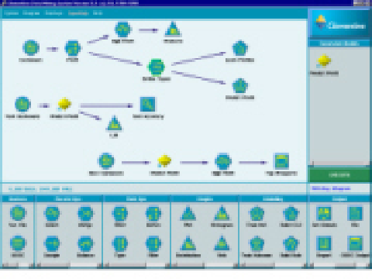
Visualization of Data Mining Processes by Clementine

Slide 31
Interactive Visual Data Mining*
Using visualization tools in the data mining process to help users make smart data mining decisions
Example
  Display the data distribution in a set of attributes using colored sectors or columns (depending on whether the whole space is represented by either a circle or a set of columns)
  Use the display to which sector should first be selected for classification and where a good split point for this sector may be

Slide 32

Interactive Visual Mining by Perception-Based Classification (PBC)

Slide 33
Audio Data Mining*
Uses audio signals to indicate the patterns of data or the features of data mining results
An interesting alternative to visual mining
An inverse task of mining audio (such as music) databases which is to find patterns from audio data
Visual data mining may disclose interesting patterns using graphical displays, but requires users to concentrate on watching patterns
Instead, transform patterns into sound and music and listen to pitches, rhythms, tune, and melody in order to identify anything interesting or unusual

Slide 34
Scientific and Statistical Data Mining (1)
There are many well-established statistical techniques for data analysis, particularly for numeric data
  applied extensively to data from scientific experiments and data from economics and the social sciences
Regression
  predict the value of a response (dependent) variable from one or more predictor (independent) variables where the variables are numeric
  forms of regression: linear, multiple, weighted, polynomial, nonparametric, and robust
Generalized linear models
  allow a categorical response variable (or some transformation of it) to be related to a set of predictor variables
  similar to the modeling of a numeric response variable using linear regression
  include logistic regression and Poisson regression

Slide 35
Scientific and Statistical Data Mining (2)
Regression trees
  Binary trees used for classification and prediction
  Similar to decision trees:Tests are performed at the internal nodes
  Difference is at the leaf level
    In a decision tree a majority voting is performed to assign a class label to the leaf
    In a regression tree the mean of the objective attribute is computed and used as the predicted value
Analysis of variance
  Analyze experimental data for two or more populations described by a numeric response variable and one or more categorical variables (factors)
Mixed-effect models
  For analyzing grouped data, i.e. data that can be classified according to one or more grouping variables
  Typically describe relationships between a response variable and some covariates in data grouped according to one or more factors

Slide 36
Scientific and Statistical Data Mining (3)
Factor analysis
  determine which vars are combined to generate a given factor
  e.g., for many psychiatric data, one can indirectly measure other quantities (such as test scores) that reflect the factor of interest
Discriminant analysis
  predict a categorical response variable, commonly used in social science
  Attempts to determine several discriminant functions (linear combinations of the independent variables) that discriminate among the groups defined by the response variable
Time series: many methods such as autoregression, ARIMA (Autoregressive integrated moving-average modeling), long memory time-series modeling
Survival analysis
  predict the probability that a patient undergoing a medical treatment would survive at least to time t (life span prediction)
Quality control
  display group summary charts

Slide 37
Theoretical Foundations of Data Mining (1)
Data reduction
  The basis of data mining is to reduce the data representation
  Trades accuracy for speed in response
Data compression
  The basis of data mining is to compress the given data by encoding in terms of bits, association rules, decision trees, clusters, etc.
Pattern discovery
  The basis of data mining is to discover patterns occurring in the database, such as associations, classification models, sequential patterns, etc.

Slide 38
Theoretical Foundations of Data Mining (2)
Probability theory
  The basis of data mining is to discover joint probability distributions of random variables
Microeconomic view
  A view of utility: the task of data mining is finding patterns that are interesting only to the extent in that they can be used in the decision-making process of some enterprise
Inductive databases
  Data mining is the problem of performing inductive logic on databases,
  The task is to query the data and the theory (i.e., patterns) of the database
  Popular among many researchers in database systems

Slide 39
Data Mining and Intelligent Query Answering*
Query answering
  Direct query answering: returns exactly what is being asked
  Intelligent (or cooperative) query answering: analyzes the intent of the query and provides generalized, neighborhood or associated information relevant to the query
Some users may not have a clear idea of exactly what to mine or what is contained in the database
Intelligent query answering analyzes the user's intent and answers queries in an intelligent way

Slide 40
Data Mining and Intelligent Query Answering (2)*
A general framework for the integration of data mining and intelligent query answering
  Data query: finds concrete data stored in a database
  Knowledge query: finds rules, patterns, and other kinds of knowledge in a database
Ex. Three ways to improve on-line shopping service
  Informative query answering by providing summary information
  Suggestion of additional items based on association analysis
  Product promotion by sequential pattern mining

Slide 41
Chapter 10: Applications and Trends in Data Mining
Data mining applications
Data mining system products and research prototypes
Additional themes on data mining
Social impact of data mining
Trends in data mining
Summary

Slide 42
Is Data Mining a Hype or Will It Be Persistent?*
Data mining is a technology
Technological life cycle
  Innovators
  Early adopters
  Chasm
  Early majority
  Late majority
  Laggards

Slide 43
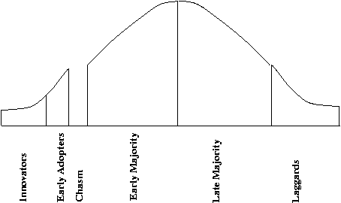
Life Cycle of Technology Adoption*
Data mining is at Chasm!?
  Existing data mining systems are too generic
  Need business-specific data mining solutions and smooth integration of business logic with data mining functions

Slide 44
Data Mining: Merely Managers' Business or Everyone's?
Data mining will surely be an important tool for managers’ decision making
  Bill Gates: “Business @ the speed of thought”
The amount of the available data is increasing, and data mining systems will be more affordable
Multiple personal uses
  Mine your family's medical history to identify genetically-related medical conditions
  Mine the records of the companies you deal with
  Mine data on stocks and company performance, etc.
Invisible data mining
  Build data mining functions into many intelligent tools

Slide 45
Social Impacts: Threat to Privacy and Data Security?*
Is data mining a threat to privacy and data security?
  “Big Brother”, “Big Banker”, and “Big Business” are carefully watching you
  Profiling information is collected every time
    You use your credit card, debit card, supermarket loyalty card, or frequent flyer card, or apply for any of the above
    You surf the Web, reply to an Internet newsgroup, subscribe to a magazine, rent a video, join a club, fill out a contest entry form,
    You pay for prescription drugs, or present you medical care number when visiting the doctor
  Collection of personal data may be beneficial for companies and consumers, there is also potential for misuse

Slide 46
Protect Privacy and Data Security*
Fair information practices
  International guidelines for data privacy protection
  Cover aspects relating to data collection, purpose, use, quality, openness, individual participation, and accountability
  Purpose specification and use limitation
  Openness: Individuals have the right to know what information is collected about them, who has access to the data, and how the data are being used
Develop and use data security-enhancing techniques
  Blind signatures
  Biometric encryption
  Anonymous databases

Slide 47
Chapter 10: Applications and Trends in Data Mining
Data mining applications
Data mining system products and research prototypes
Additional themes on data mining
Social impact of data mining
Trends in data mining
Summary

Slide 48
Trends in Data Mining (1)*
Application exploration
  development of application-specific data mining system
  Invisible data mining (mining as built-in function)
Scalable data mining methods
  Constraint-based mining: use of constraints to guide data mining systems in their search for interesting patterns
Integration of data mining with database systems, data warehouse systems, and Web database systems

Slide 49
Trends in Data Mining (2)*
Standardization of data mining language
  A standard will facilitate systematic development, improve interoperability, and promote the education and use of data mining systems in industry and society
Visual data mining
New methods for mining complex types of data
  More research is required towards the integration of data mining methods with existing data analysis techniques for the complex types of data
Web mining
Privacy protection and information security in data mining

Slide 50
Chapter 10: Applications and Trends in Data Mining
Data mining applications
Data mining system products and research prototypes
Additional themes on data mining
Social impact of data mining
Trends in data mining
Summary

Slide 51
Summary
Domain-specific applications include biomedicine (DNA), finance, retail and telecommunication data mining
There exist some data mining systems and it is important to know their power and limitations
Visual data mining include data visualization, mining result visualization, mining process visualization and interactive visual mining
There are many other scientific and statistical data mining methods developed but not covered in this book
Also, it is important to study theoretical foundations of data mining
Intelligent query answering can be integrated with mining
It is important to watch privacy and security issues in data mining

Slide 52
References (1)
M. Ankerst, C. Elsen, M. Ester, and H.-P. Kriegel. Visual classification: An interactive approach to decision tree construction. KDD'99, San Diego, CA, Aug. 1999.
P. Baldi and S. Brunak. Bioinformatics: The Machine Learning Approach. MIT Press, 1998.
S. Benninga and B. Czaczkes. Financial Modeling. MIT Press, 1997.
L. Breiman, J. Friedman, R. Olshen, and C. Stone. Classification and Regression Trees. Wadsworth International Group, 1984.
M. Berthold and D. J. Hand. Intelligent Data Analysis: An Introduction. Springer-Verlag, 1999.
M. J. A. Berry and G. Linoff. Mastering Data Mining: The Art and Science of Customer Relationship Management. John Wiley & Sons, 1999.
A. Baxevanis and B. F. F. Ouellette. Bioinformatics: A Practical Guide to the Analysis of Genes and Proteins. John Wiley & Sons, 1998.
Q. Chen, M. Hsu, and U. Dayal. A data-warehouse/OLAP framework for scalable telecommunication tandem traffic analysis. ICDE'00, San Diego, CA, Feb. 2000.
W. Cleveland. Visualizing Data. Hobart Press, Summit NJ, 1993.
S. Chakrabarti, S. Sarawagi, and B. Dom. Mining surprising patterns using temporal description length. VLDB'98, New York, NY, Aug. 1998.

Slide 53
References (2)
J. L. Devore. Probability and Statistics for Engineering and the Science, 4th ed. Duxbury Press, 1995.
A. J. Dobson. An Introduction to Generalized Linear Models. Chapman and Hall, 1990.
B. Gates. Business @ the Speed of Thought. New York: Warner Books, 1999.
M. Goebel and L. Gruenwald. A survey of data mining and knowledge discovery software tools. SIGKDD Explorations, 1:20-33, 1999.
D. Gusfield. Algorithms on Strings, Trees and Sequences, Computer Science and Computation Biology. Cambridge University Press, New York, 1997.
J. Han, Y. Huang, N. Cercone, and Y. Fu. Intelligent query answering by knowledge discovery techniques. IEEE Trans. Knowledge and Data Engineering, 8:373-390, 1996.
R. C. Higgins. Analysis for Financial Management. Irwin/McGraw-Hill, 1997.
C. H. Huberty. Applied Discriminant Analysis. New York: John Wiley & Sons, 1994.
T. Imielinski and H. Mannila. A database perspective on knowledge discovery. Communications of ACM, 39:58-64, 1996.
D. A. Keim and H.-P. Kriegel. VisDB: Database exploration using multidimensional visualization. Computer Graphics and Applications, pages 40-49, Sept. 94.

Slide 54
References (3)
J. M. Kleinberg, C. Papadimitriou, and P. Raghavan. A microeconomic view of data mining. Data Mining and Knowledge Discovery, 2:311-324, 1998.
H. Mannila. Methods and problems in data mining. ICDT'99 Delphi, Greece, Jan. 1997.
R. Mattison. Data Warehousing and Data Mining for Telecommunications. Artech House, 1997.
R. G. Miller. Survival Analysis. New York: Wiley, 1981.
G. A. Moore. Crossing the Chasm: Marketing and Selling High-Tech Products to Mainstream Customers. Harperbusiness, 1999.
R. H. Shumway. Applied Statistical Time Series Analysis. Prentice Hall, 1988.
E. R. Tufte. The Visual Display of Quantitative Information. Graphics Press, Cheshire, CT, 1983.
E. R. Tufte. Envisioning Information. Graphics Press, Cheshire, CT, 1990.
E. R. Tufte. Visual Explanations : Images and Quantities, Evidence and Narrative. Graphics Press, Cheshire, CT, 1997.
M. S. Waterman. Introduction to Computational Biology: Maps, Sequences, and Genomes (Interdisciplinary Statistics). CRC Press, 1995.

Slide 55

http://www.cs.sfu.ca/~han/dmbook
Thank you !!!

